Slide 1
Topics to be Covered:
Java Applet – Introduction
Life Cycle of an Applet
  Life cycle methods of applet
  Example of applet
GUI with Applet
  Graphics in applet
  Displaying an image in applet
  Painting in applet
  Parameters in applet

Slide 2
Java Applet

Slide 3
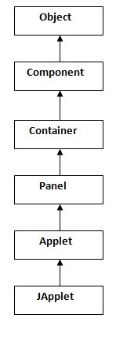
Java Applet - Introduction
Hierarchy of Applet
An applet is a special type of program that is embedded in the webpage to generate dynamic content. It runs inside the browser and works on the client side.
Advantage of Applet
It works on the client side so less response time.
It is Secured
It can be executed by browsers running under many platforms, including Linux, Windows, Mac Os etc.
Drawback of Applet
Plugin is required in the client browser to execute the applet.
As displayed in the above diagram, Applet class extends Panel. Panel class extends Container which is the subclass of Component.

Slide 4
Life Cycle of Applet

Slide 5
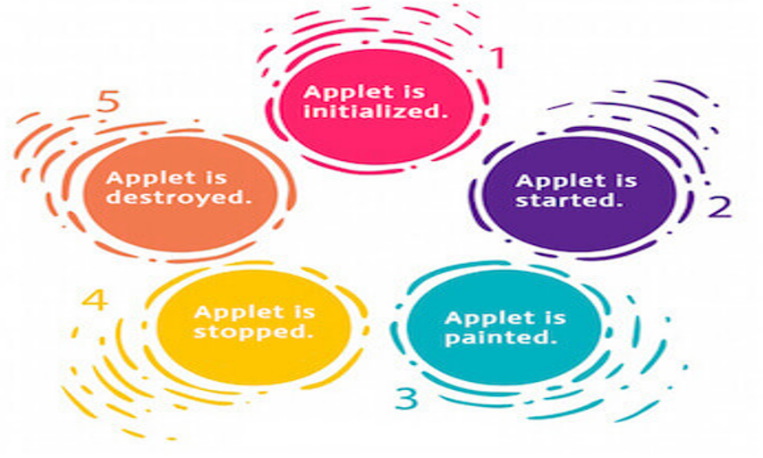
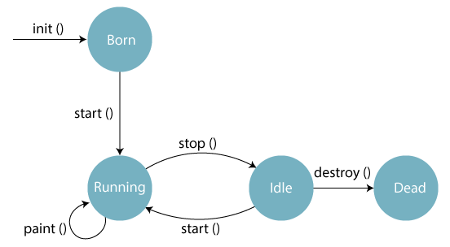
Life Cycle of Applet

Slide 6
Life Cycle Methods of Applet

Slide 7
Life Cycle Methods of Applet
The java.applet.Applet class 4 life cycle methods and java.awt.Component class provides 1 life cycle methods for an applet.
java.applet.Applet class :
For creating any applet java.applet.Applet class must be inherited. It provides 4 life cycle methods of applet.
public void init(): is used to initialize the Applet. It is invoked only once.
public void start(): is invoked after the init() method or browser is maximized. It is used to start the Applet.
public void stop(): is used to stop the Applet. It is invoked when Applet is stopped or the browser is minimized.
public void destroy(): is used to destroy the Applet. It is invoked only once.
java.awt.Component class :
The Component class provides one life cycle method of applet.
public void paint(Graphics g): is used to paint the Applet. It provides Graphics class object that can be used for drawing oval, rectangle, arc etc.initialize

Slide 8
Example of Applet

Slide 9
Applet : Example 01
To execute the applet by html file, create an applet and compile it.
After that create an html file and place the applet code in html file. Now open the html file.
//First.java
import java.applet.Applet;
import java.awt.Graphics;
public class First extends Applet
{
public void paint(Graphics g)
{
g.drawString("welcome",150,150);
}
}
// myapplet.html
<html>
<body>
<applet code="First.class" width="300" height="300">
</applet>
</body>
</html>
Open the browser : type d:\myapplet.html in address bar
( Assuming myapplet.html is saved in d: drive )
Compile the file using javac First.java

Slide 10
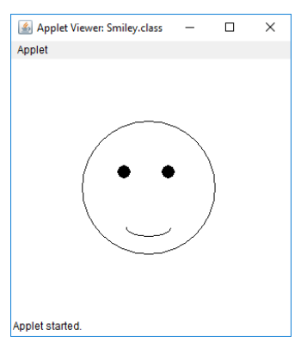
Applet : Example 02
// Java program to Draw a Smiley using Java Applet
import java.applet.*;
import java.awt.*;
/*<applet code ="Smiley" width=600 height=600>
</applet>*/
public class Smiley extends Applet
{
public void paint(Graphics g)
{
g.drawOval(80, 70, 150, 150); // Oval for face outline
// Ovals for eyes with black color filled
g.setColor(Color.BLACK);
g.fillOval(120, 120, 15, 15);
g.fillOval(170, 120, 15, 15);
// Arc for the smile
g.drawArc(130, 180, 50, 20, 180, 180);
}
}

Slide 11
GUI with Applet

Slide 12
Displaying Graphics in Applet
java.awt.Graphics class provides many methods for graphics programming.
public abstract void drawString(String str, int x, int y): is used to draw the specified string.
public void drawRect(int x, int y, int width, int height): draws a rectangle with the specified width and height.
public abstract void fillRect(int x, int y, int width, int height): is used to fill rectangle with the default color and specified width and height.
public abstract void drawOval(int x, int y, int width, int height): is used to draw oval with the specified width and height.
public abstract void fillOval(int x, int y, int width, int height): is used to fill oval with the default color and specified width and height.
public abstract void drawLine(int x1, int y1, int x2, int y2): is used to draw line between the points(x1, y1) and (x2, y2).
public abstract boolean drawImage(Image img, int x, int y, ImageObserver observer): is used draw the specified image.
public abstract void drawArc(int x, int y, int width, int height, int startAngle, int arcAngle): is used draw a circular or elliptical arc.
public abstract void fillArc(int x, int y, int width, int height, int startAngle, int arcAngle): is used to fill a circular or elliptical arc.
public abstract void setColor(Color c): is used to set the graphics current color to the specified color.
public abstract void setFont(Font font): is used to set the graphics current font to the specified font.

Slide 13
Displaying Graphics in Applet
//GraphicsDemo.java
import java.applet.Applet;
import java.awt.*;
public class GraphicsDemo extends Applet
{
public void paint(Graphics g)
{
g.setColor(Color.red);
g.drawString("Welcome",50, 50);
g.drawLine(20,30,20,300);
g.drawRect(70,100,30,30);
g.fillRect(170,100,30,30);
g.drawOval(70,200,30,30);
g.setColor(Color.pink);
g.fillOval(170,200,30,30);
g.drawArc(90,150,30,30,30,270);
g.fillArc(270,150,30,30,0,180);
}
}
//helloapplet.html
<html>
<body>
<applet code="GraphicsDemo.class" width="300" height="300">
</applet>
</body>
</html>

Slide 14
Displaying Image in Applet
Applet is mostly used in games and animation. For this purpose image is required to be displayed. The java.awt.Graphics class provide a method drawImage() to display the image.
The java.applet.Applet class provides getImage() method that returns the object of Image.
public Image getImage(URL u, String image){}
Other required methods of Applet class to display image:
public URL getDocumentBase(): is used to return the URL of the document in which applet is embedded.
public URL getCodeBase(): is used to return the base URL.

Slide 15
Displaying Image in Applet : Example
//GraphicsDemo.java
import java.awt.*;
import java.applet.*;
public class DisplayImage extends Applet
{
Image picture;
public void init()
{
picture = getImage(getDocumentBase(),“hello.jpg");
}
public void paint(Graphics g)
{
g.drawImage(picture, 30,30, this);
}
}
//helloapplet.html
<html>
<body>
<applet code=" DisplayImage.class"
width="300" height="300">
</applet>
</body>
</html>

Slide 16
Painting in Applet : Example
We can perform painting operation in applet by the mouseDragged() method of MouseMotionListener.
import java.awt.*;
import java.awt.event.*;
import java.applet.*;
public class MouseDrag extends Applet implements MouseMotionListener
{
public void init()
{
addMouseMotionListener(this);
setBackground(Color.red);
}
public void mouseDragged(MouseEvent me)
{
Graphics g=getGraphics();
g.setColor(Color.white);
g.fillOval(me.getX(),me.getY(),5,5);
}
public void mouseMoved(MouseEvent me){}
}
<html>
<body>
<applet code="MouseDrag.class" width="300" height="300">
</applet>
</body>
</html>

Slide 17
Parameter in Applet : Example
We can get any information from the HTML file as a parameter. For this purpose, Applet class provides a method named getParameter().
Syntax: public String getParameter(String parameterName)
import java.applet.Applet;
import java.awt.Graphics;
public class UseParam extends Applet
{
public void paint(Graphics g)
{
String str=getParameter("msg");
g.drawString(str,50, 50);
}
}
<html>
<body>
<applet code="UseParam.class" width="300" height="300">
<param name="msg" value="Welcome to applet">
</applet>
</body>
</html>

Slide 18
Thank You

